Slide 1


CMT Paper ID: 206
PREDICTING BREAST CANCER SURVIVAL AN APPROACH USING DEEP LEARNING AND MACHINE LEARNING TECHNIQUES
Presented by
Chennupalli Chandrika Tirumala
Team members details
Kodavati Jayamma
Parlapalli Haseena
Authors Name
1. Soma Sekhar Kolisetty
2. Chennupalli Chandrika Tirumala
3. Kodavati Jayamma
4. Parlapalli Haseena
5. Kathi Chandra Mouli
6. Anitha Vulugundam
Affiliation
Dept. of CSE,
Narasaraopet Engineering College (1,2,3,4)
Dept. of CSE, GRIET (5)
Dept. of ETM, GNITS (6)
Notes:
1.7.2013
1.7.2013
1.7.2013
1.7.2013
‹#›
‹#›
‹#›
‹#›

Slide 2
Content
❖Introduction
❖Problem Statements
❖Objectives
❖Methodology
❖Result & Discussion
❖Conclusion & Future Scope
❖References
Notes:
1.7.2013
1.7.2013
1.7.2013
1.7.2013
‹#›
‹#›
‹#›
‹#›

Slide 3
Introduction:
Breast cancer remains one of the most common causes of death among women worldwide.
Survival analysis helps predict the time until an event (death or relapse) and can handle censored patient data.
The Cox Proportional Hazards (CoxPH) model is widely used but assumes linear and proportional hazard relationships.
To capture nonlinear and time-dependent patterns, advanced machine learning and deep learning models are used.
This study evaluates CoxPH, Random Forest Survival (RFS), DeepSurv, DeepHit, and
SA-DGNet using the METABRIC dataset.
The objective is to improve accuracy and interpretability in breast cancer survival prediction through self-attention and gated mechanisms.

Slide 4
Problem Statement:
Breast cancer remains a major cause of mortality among women, requiring accurate survival prediction for better treatment planning.
Traditional models like CoxPH assume linear and proportional hazards, limiting their ability to capture complex data patterns.
Machine learning models such as RFS handle nonlinear data but lack clinical interpretability.
Deep learning models (DeepSurv , DeepHit) struggle to learn both short- and long-term dependencies effectively.
There is a need for a model that ensures high accuracy, temporal dependency learning, and interpretability — addressed through the proposed SA-DGNet model.

Slide 5
Objectives:
To predict breast cancer patient survival using the METABRIC dataset containing clinical and genomic data.
To compare the performance of classical (CoxPH), machine learning (RFS), and deep learning models (DeepSurv, DeepHit, SA-DGNet) for survival analysis.
To implement and evaluate SA-DGNet, a deep learning model that combines Gated Layers and Self-Attention to capture short- and long-term dependencies.
To enhance interpretability by generating feature importance plots and attention heatmaps that identify influential clinical and genomic factors.
To develop a balanced framework that improves prediction accuracy, interpretability, and clinical applicability for breast cancer survival prediction.

Slide 6
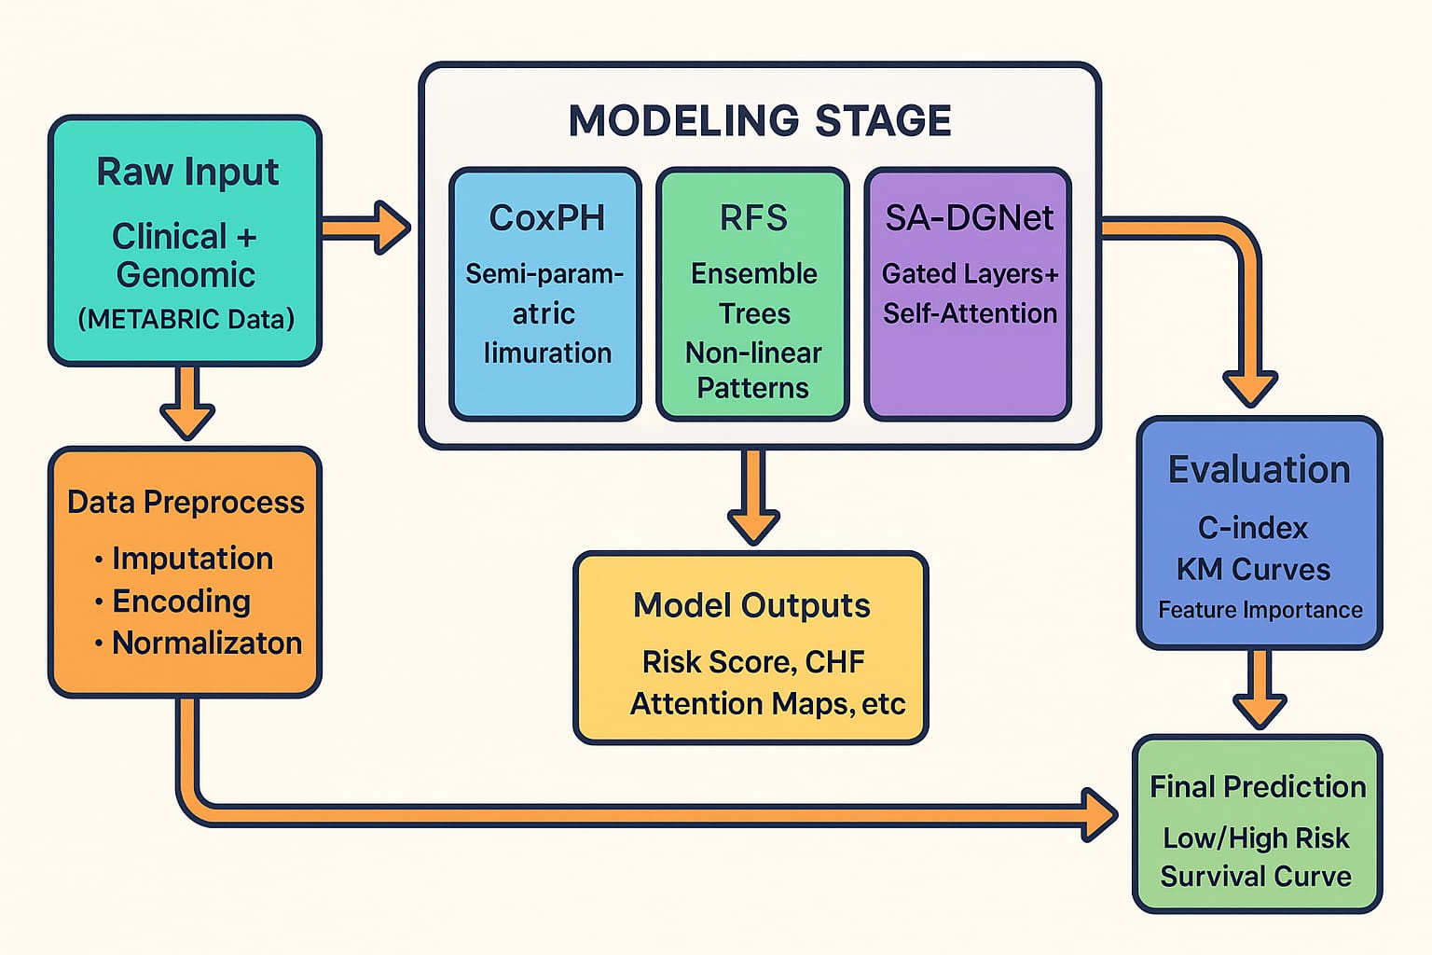
Methodology :
Proposed Explainable Machine Learning & Deep Learning Framework
1️⃣ Data Collection:
The study uses the METABRIC (Molecular Taxonomy of Breast Cancer International Consortium) dataset.
It contains clinical and genomic features of over 1,900 breast cancer patients.
Each record includes survival time and an event indicator representing whether the event (death) occurred or was censored.
2️⃣ Data Preprocessing:
Handling Missing Values: Imputed using median or mode values.
Encoding: Categorical variables are converted to numeric format using one-hot encoding.
Normalization: Continuous variables are scaled using Min–Max normalization to bring all features into a common range.

Slide 7
3️⃣ Modeling Stage
Cox Proportional Hazards(CoxPH):A semi-parametric model estimating hazard ratios to identify the effect of clinical features on survival.
• Random Forest Survival (RFS): An ensemble-based method capturing nonlinear relationships and generating cumulative hazard functions.
• Self-Attentive Deep Gated Network(SA-DGNet):A deep learning model combining Gated Layers (for nonlinear feature regulation) and Self-Attention Mechanisms (for long- and short-term dependency capture).
4️⃣ Model Evaluation
Concordance Index (C-index): Measures how well the model ranks patient survival times.
Kaplan–Meier Curves (KM): Visualize predicted survival probabilities for high- and low-risk groups.
Feature Importance & Attention Maps: Identify the most influential features contributing to patient survival.

Slide 8
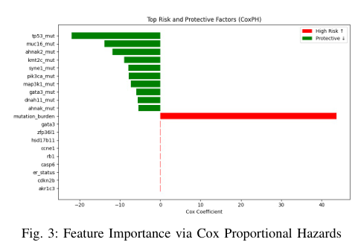
Result & Discussion
The figure displays the top risk (red) and protective (green) features identified using the Cox Proportional Hazards (CoxPH) model.
Positive Cox coefficients indicate features that increase the risk of poor survival (high-risk factors).
Negative coefficients correspond to protective features that are associated with better survival outcomes.
Mutation burden is observed as the most significant high-risk feature, showing a strong positive coefficient.
Genes such as TP53, MUC16, and AHNAK2 act as protective factors, demonstrating negative Cox coefficients that suggest a survival advantage.

Slide 9
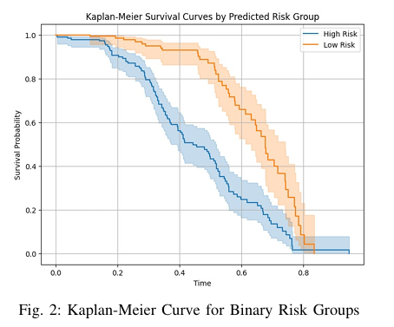
Interpretation of Kaplan–Meier Survival Analysis
The Kaplan–Meier (KM) curve visualizes the survival probability over time for patients grouped into high-risk and low-risk categories based on model predictions.
The x-axis represents time, while the y-axis indicates the probability of patient survival.
The blue curve corresponds to the high-risk group, which shows a faster decline in survival probability, indicating poorer outcomes.
The orange curve represents the low-risk group, maintaining a higher survival probability throughout the observation period.
The clear separation between the two curves demonstrates that the model effectively differentiates between high- and low-risk patients, validating its prognostic capability.

Slide 10
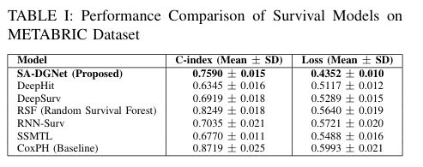
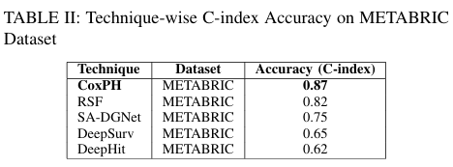
Table I shows the performance comparison of various survival models on the METABRIC dataset. The proposed SA-DGNet model demonstrates a strong balance with a C-index of 0.7590 and the lowest loss value (0.4352), indicating improved predictive stability and accuracy over other models.
Table II presents the C-index accuracy comparison of various survival prediction models on the METABRIC dataset. Among all techniques, the CoxPH model achieved the highest performance with a C-index of 0.87, indicating superior predictive capability.

Slide 11
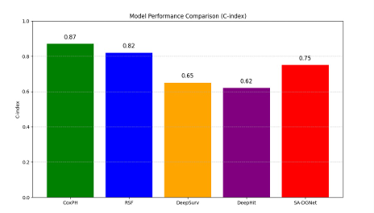
This bar chart compares the performance of different survival prediction models using the C-index.
The x-axis shows the models: CoxPH, RSF, DeepSurv, DeepHit, and SA-DGNet.
The y-axis shows the C-index values (higher means better performance).
CoxPH (0.87) performed the best.
RSF (0.82) also gave good results.
SA-DGNet (0.75) showed better performance than DeepSurv and DeepHit.
DeepSurv (0.65) and DeepHit (0.62) had lower accuracy.
CoxPH and RSF models work best, while SA-DGNet gives a fair balance with improved deep learning performance.

Slide 12
Conclusion
The study analyzed and compared multiple survival prediction models — CoxPH, RFS, DeepSurv, DeepHit, and SA-DGNet — using the METABRIC breast cancer dataset.
CoxPH achieved the highest accuracy (C-index = 0.87) and proved effective for structured clinical data.
The proposed SA-DGNet model successfully captured both short- and long-term feature dependencies through gated layers and self-attention mechanisms.
The integration of classical, machine learning, and deep learning approaches improved both accuracy and interpretability.
The overall research demonstrates that deep attention-based models like SA-DGNet can support personalized survival prediction and clinical decision-making.
Future Scope
Integration of Multimodal Data: Combine clinical, genomic, and imaging data for more comprehensive survival prediction.
Real-Time Clinical Application: Implement the SA-DGNet model into decision-support systems for hospitals and healthcare platforms.
Model Optimization: Apply transfer learning and hyperparameter tuning to improve performance on smaller or imbalanced datasets.
Explainable AI Improvements: Develop advanced visualization techniques for attention and gating outputs to improve clinical trust.
Cross-Disease Validation: Extend and evaluate the proposed framework on other cancer types (e.g., lung, ovarian, or prostate) to test its generalization.

Slide 13
References
[1] D. R. Cox, “Regression Models and Life-Tables (with Discussion),” Journal of the Royal Statistical Society: Series B (Methodological), vol. 34, no. 2, pp. 187–220, 1972.
[2] H. Ishwaran, U. B. Kogalur, E. H. Blackstone, and M. S. Lauer, “Random survival forests for R,” Bioinformatics, vol. 23, no. 4, pp. 673–679, 2007.
[3] J. Katzman, U. Shaham, A. Cloninger, J. Bates, T. Jiang, and Y. Kluger, “DeepSurv: Personalized Treatment Recommender System Using a Cox Proportional Hazards Deep Neural Network,” BMC Medical Research Methodology, vol. 18, no. 24, pp. 1–12, 2018.
[4] C. Lee, W. R. Zame, J. Yoon, and M. van der Schaar, “Deephit: A deep learning approach to survival analysis with competing risks,” in Proc. AAAI Conf. Artificial Intelligence, vol. 32, no. 1, pp. 2314–2321, 2018.
[5] X. Yang and H. Qiu, “Deep Gated Neural Network With Self-Attention Mechanism for Survival Analysis,” IEEE Journal of Biomedical and Health Informatics, vol. 29, no. 1, pp. 105–115, 2025.
Acknowledgements
We sincerely thank our guide, Soma Sekhar Kolisetty, Professor, Department of CSE, for his continuous guidance and encouragement.
We extend our gratitude to the Department of Computer Science and Engineering, Narasaraopeta Engineering College (Autonomous) for providing the necessary support and facilities.
We also thank our friends and family members for their motivation and help throughout the project.
Finally, we would like to thank the INCOWOCO 2025 Conference Committee for giving us the opportunity to present our research work on such a prestigious platform

Slide 14
THANK YOU

